Slide 1
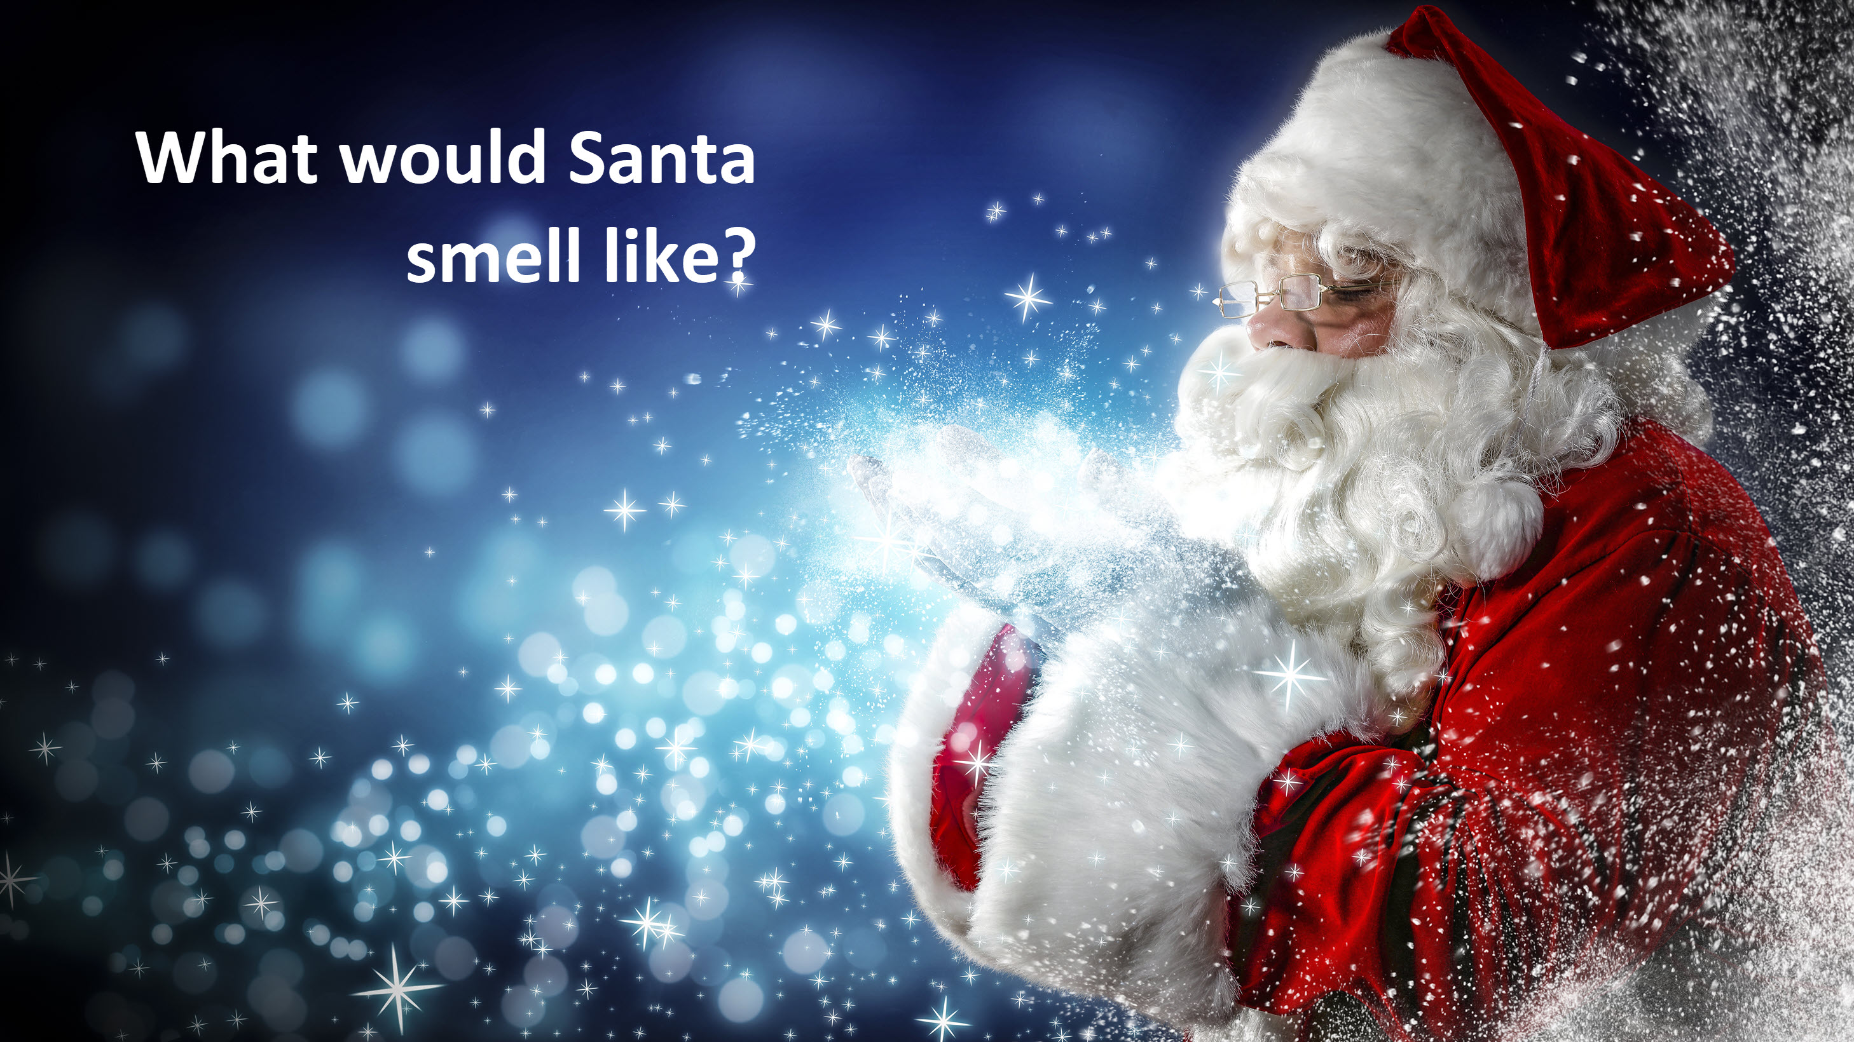

Slide 2
What would Santa smell like?
What might different people say?
Imagine his journey!
What does he do? Where do he go? What smells are there?

Slide 3
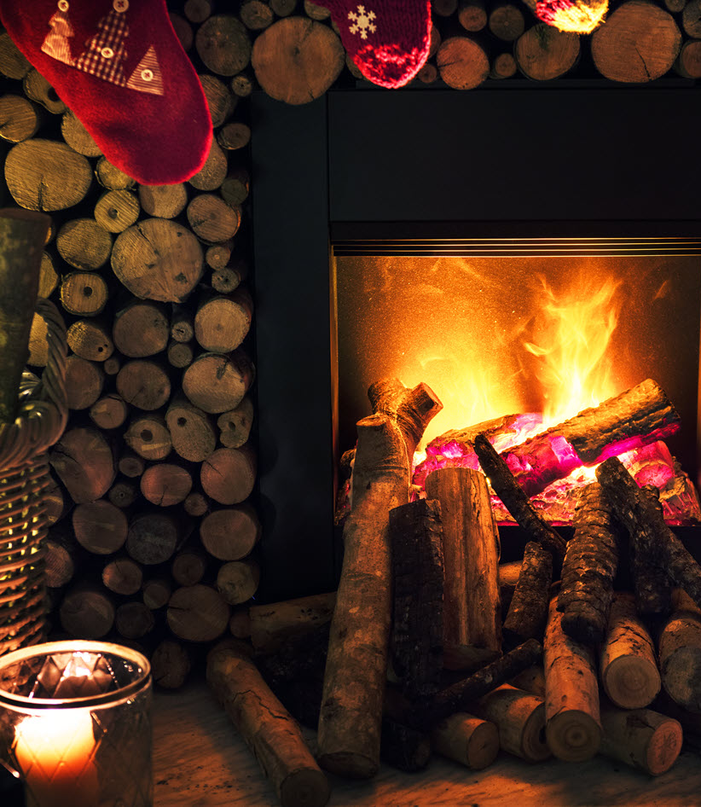
What would Santa smell like?
A question Orchadia first asked in 2016…
Here’s what they found!
At work, the first answer we had was ‘soot and sweat’, clearly from a hard-working Santa, absorbing smells from the innards of many chimneys and producing his own personal scent as the long night progressed.

Slide 4
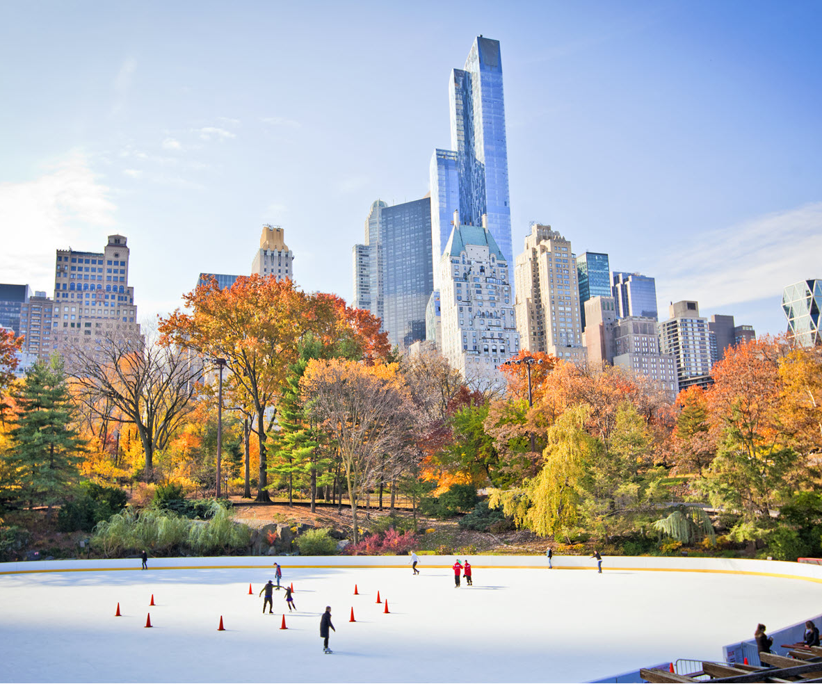
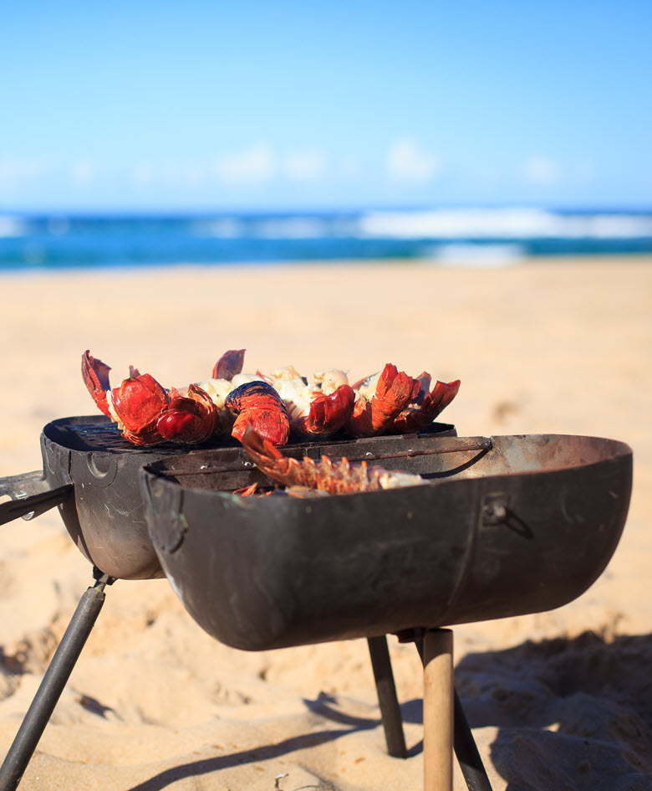
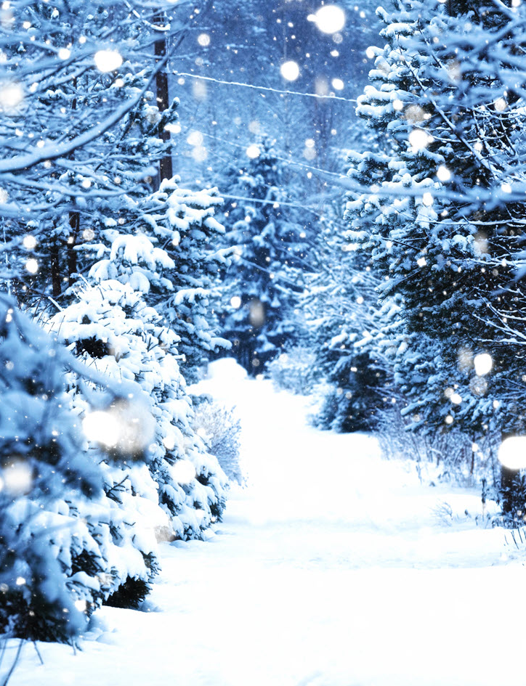
What would Santa smell like?
Contributions from the USA included the New York night sky just before snowfall, and from Canada the first snow of winter on the pine woods. From Australia, Santa smells of countless beach barbecues.

Slide 5
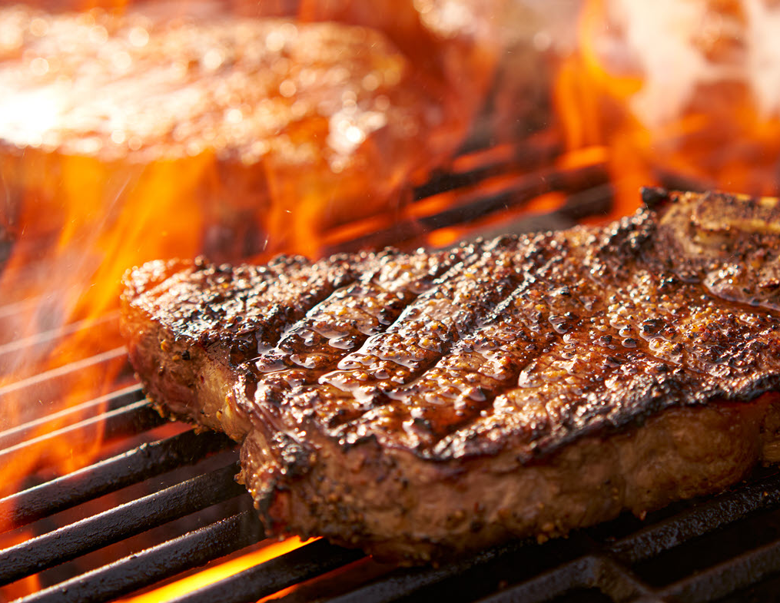
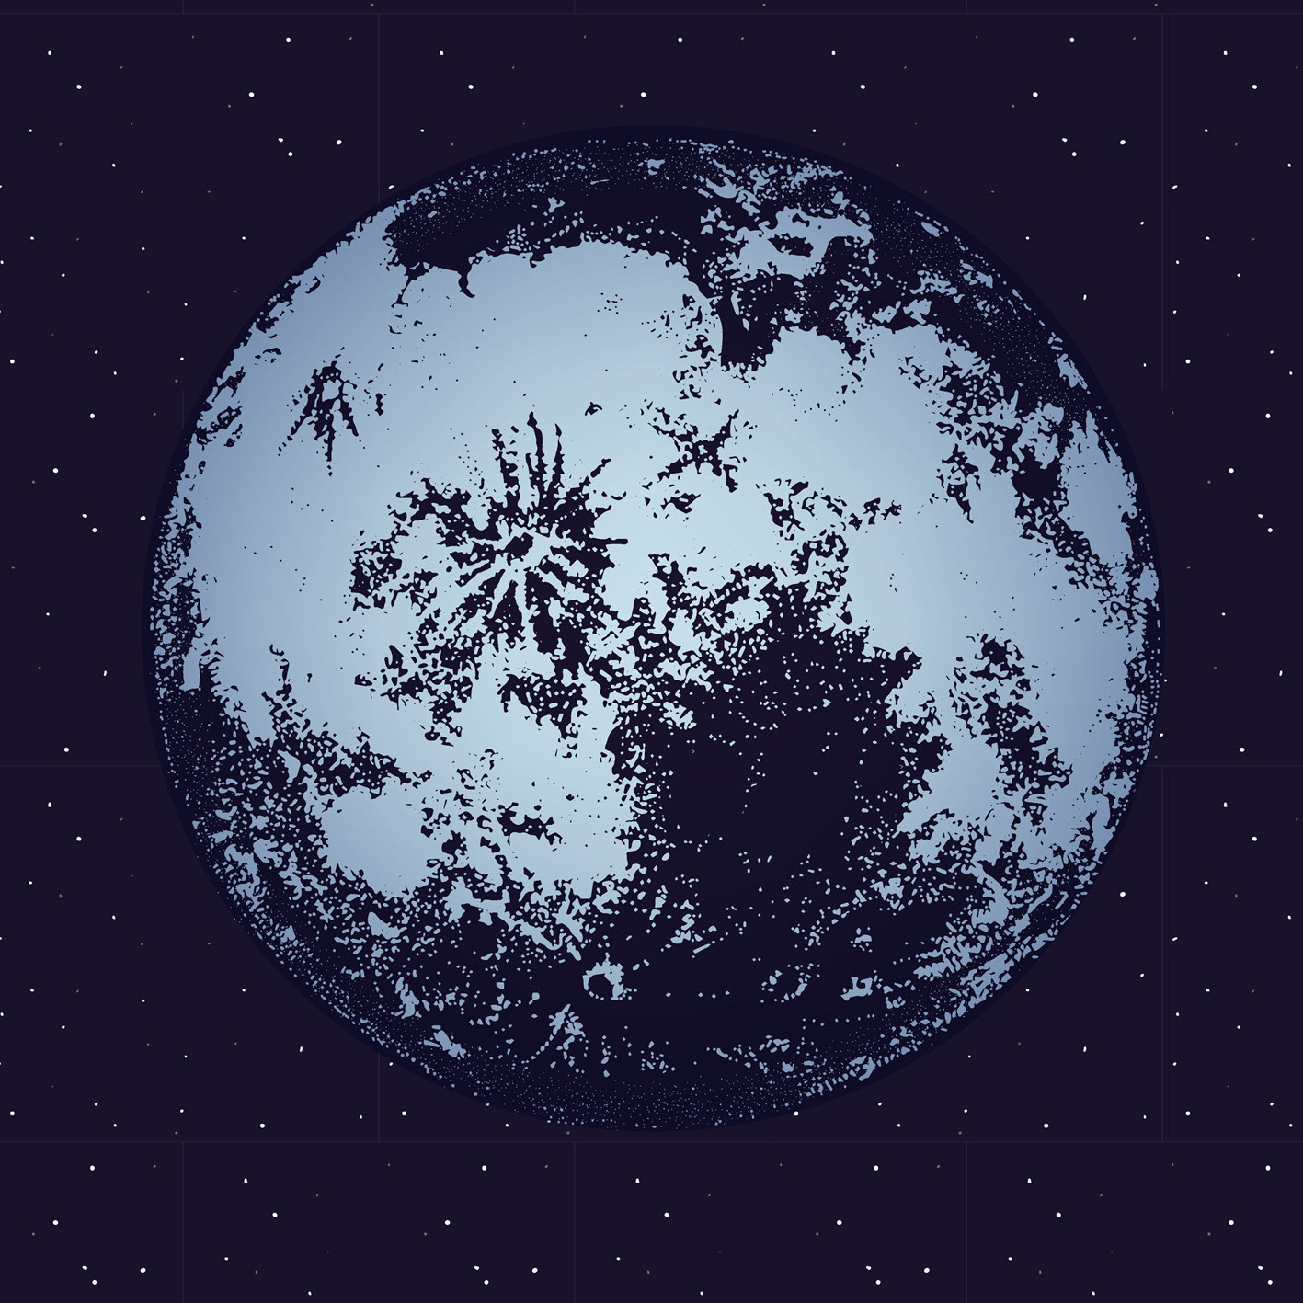
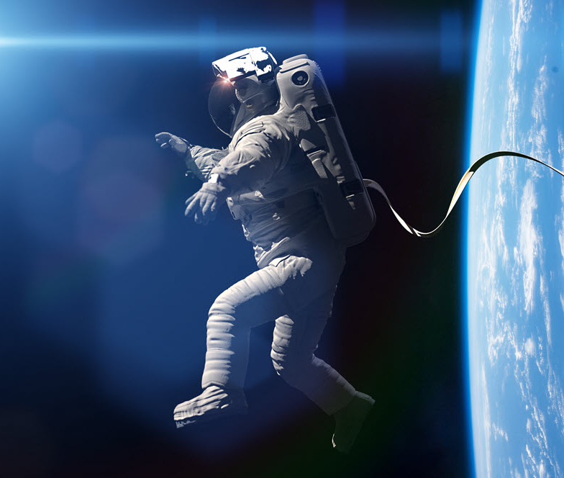
What would Santa smell like?
We were told Santa smells of nose-tingling magic, moonlight and Santa was fantastical too, smelling of starry nights from his journey through the night sky. The smell is cool, magical, twinkling.
Another cosmic reply was Santa smells like space, perhaps with a little whiskey.
As it turns out ‘space’ smells like seared meat, hot metal, barbecue. Astronauts are quite consistent in their description of the smell, captured on their suits during space walks and transferred inside on their return. It’s thought this smell originates from dying stars.

Slide 6
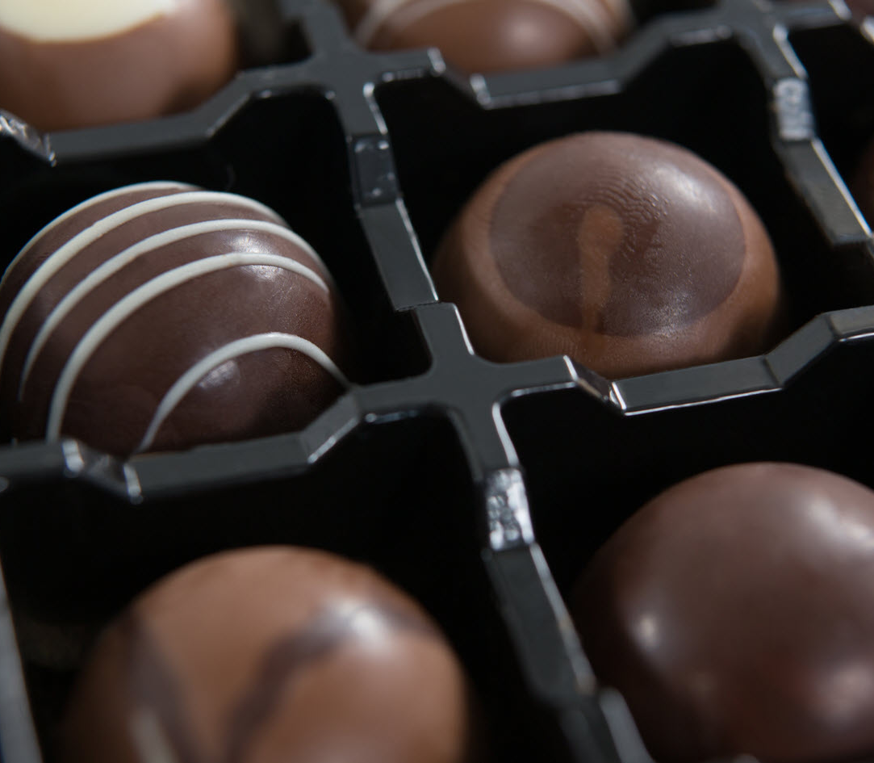
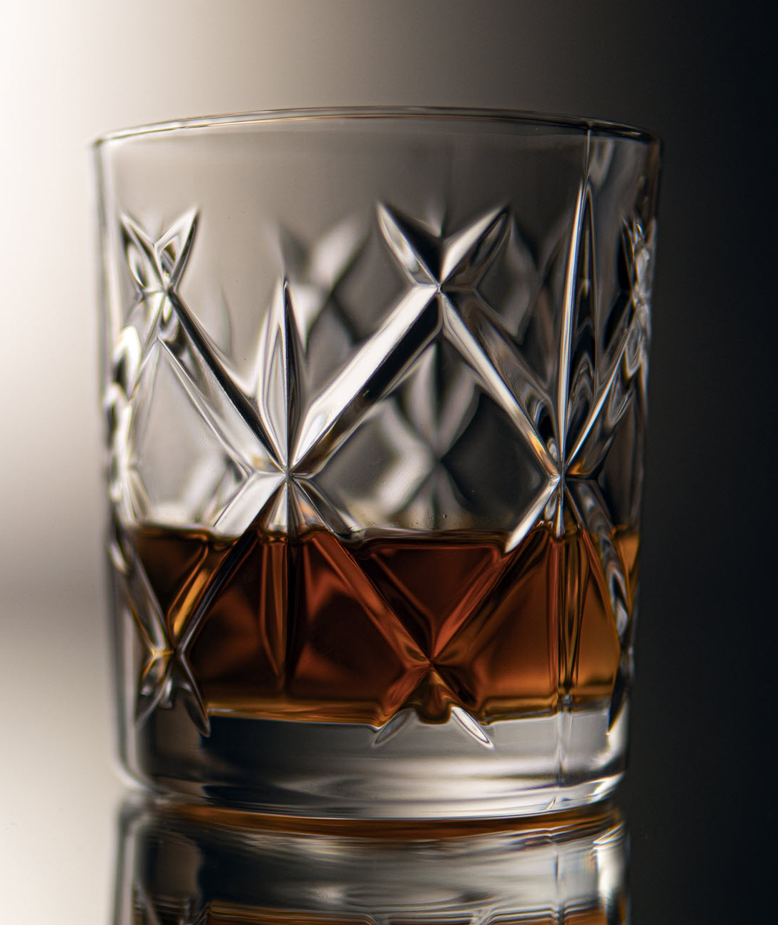
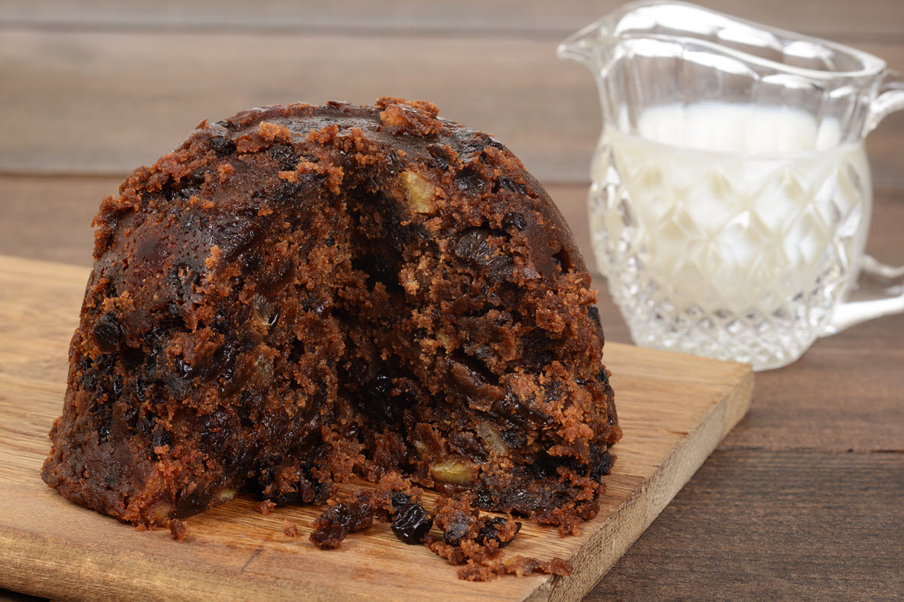
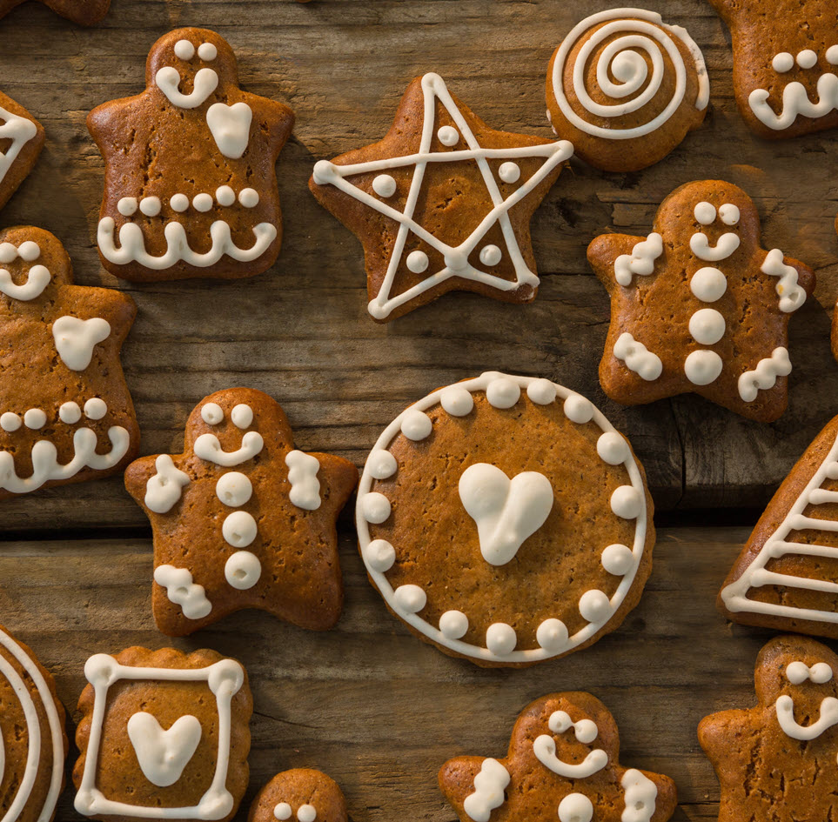
What would Santa smell like?
Some children we asked said Santa smells of milk and biscuits, the snacks he’s presented with at each stopping point. Until about aged 14 when it switched to sherry or brandy and mince pies.
Food and drink was a major theme, with cinnamon, gingerbread and mince pies appearing most often, yummy! Santa also smells of chocolate, cookies, lollipops, sweet pastry, peppermint, cognac, and beer.

Slide 7
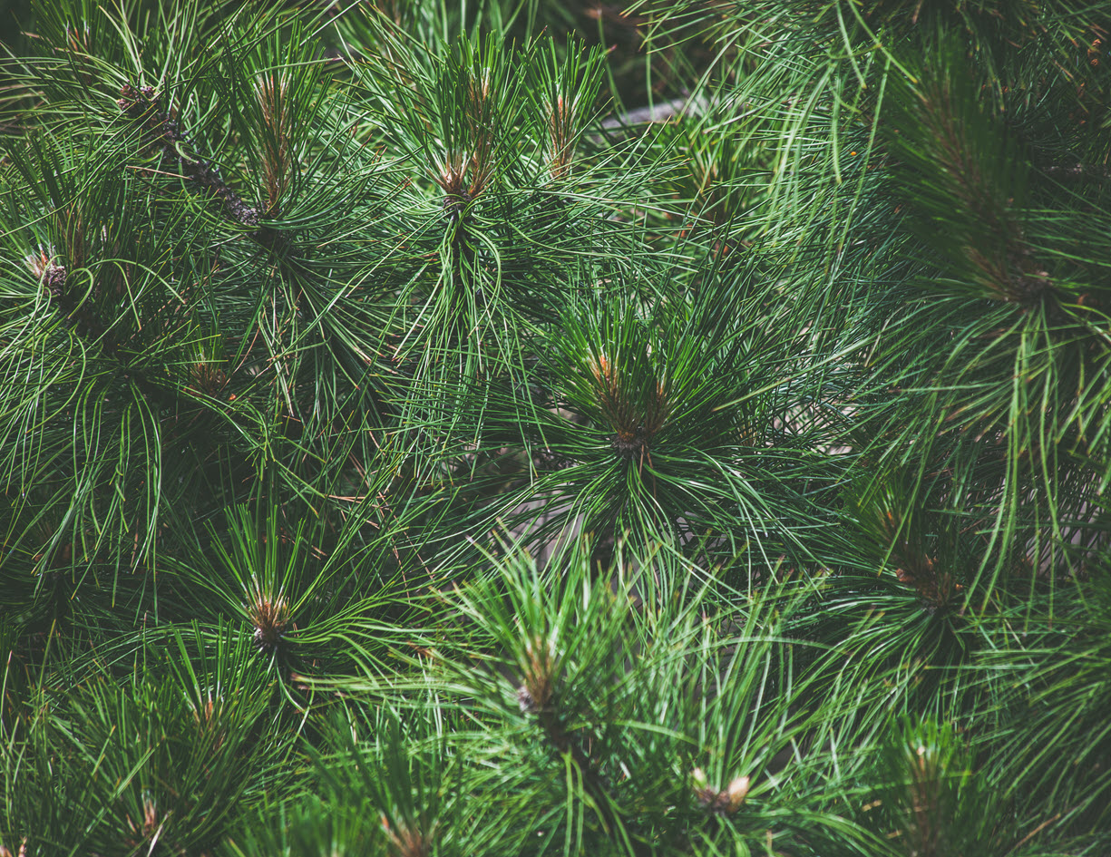
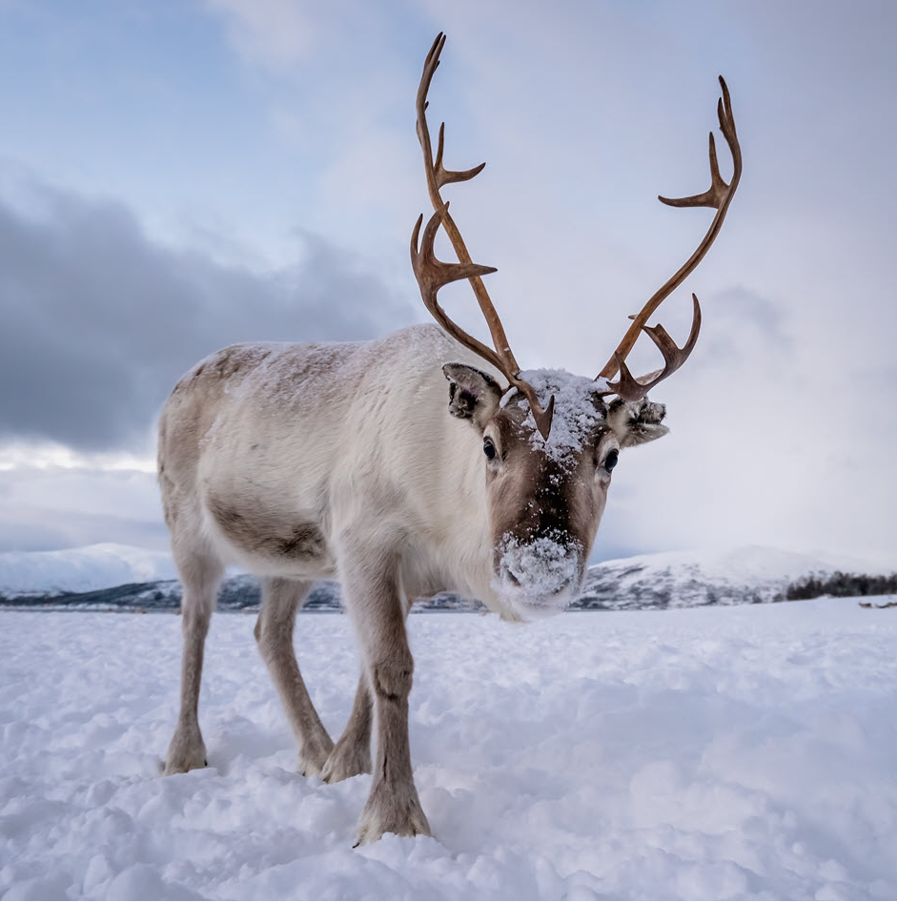
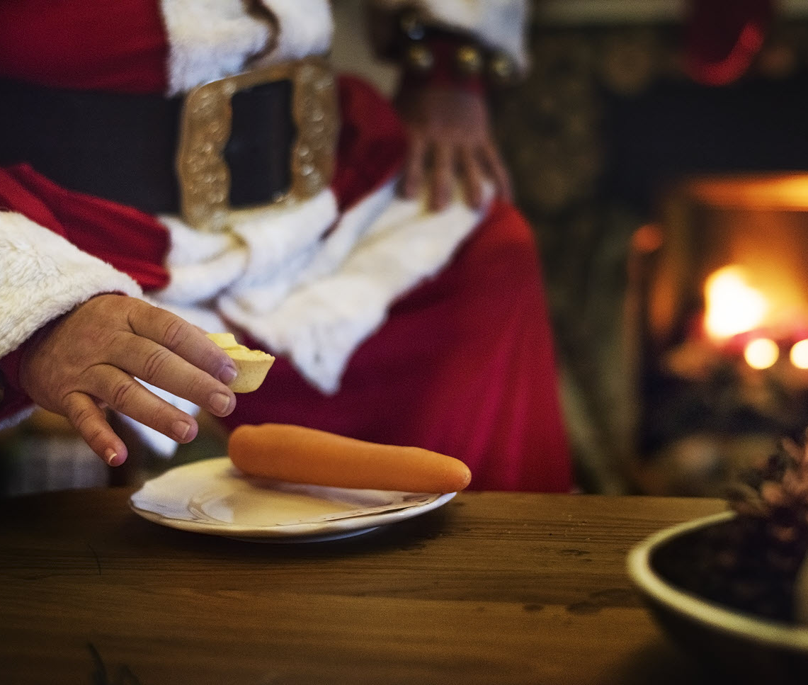
What would Santa smell like?
Santa smells of brass and of saddle soap from holding reins all night. His ancient beard smells of lanolin and pipe tobacco, he also smells of leather, boot polish, velvet and moth balls.
Others said Santa smells of reindeer droppings!
Some said Santa smells of pine trees, brushing past them on his journey and again when placing presents under trees in hopeful homes.

Slide 8
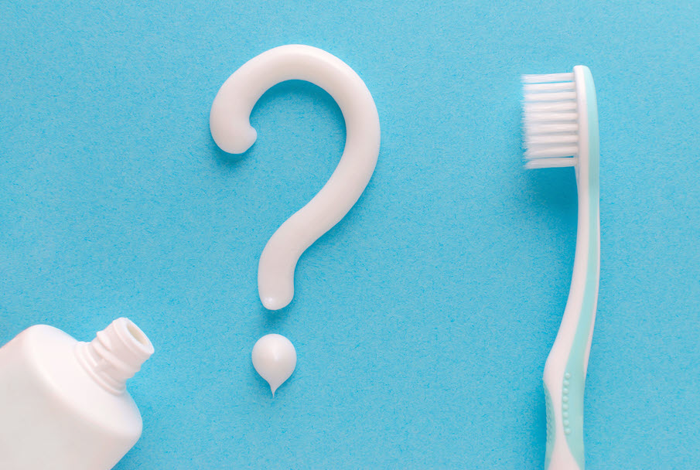
What would Santa smell like? Time to smell!!
Tooth paste
What do you smell?
How would you describe the mint smell? Is it…
Peppermint, spearmint, fresh, sweet, sharp?
Does it feel cool in your nose?

Slide 9
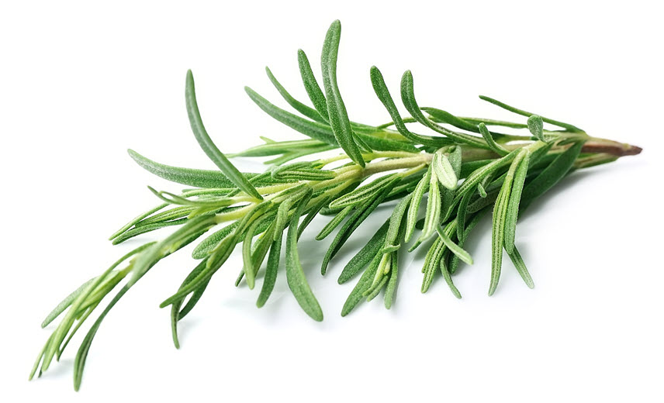
What would Santa smell like? Time to smell!!
Rosemary
What do you smell?
How would you describe it? Is it…
Herbal, piney, fresh, strong or mild?
How does it make you feel?
If you don’t have fresh rosemary, you can use dried

Slide 10
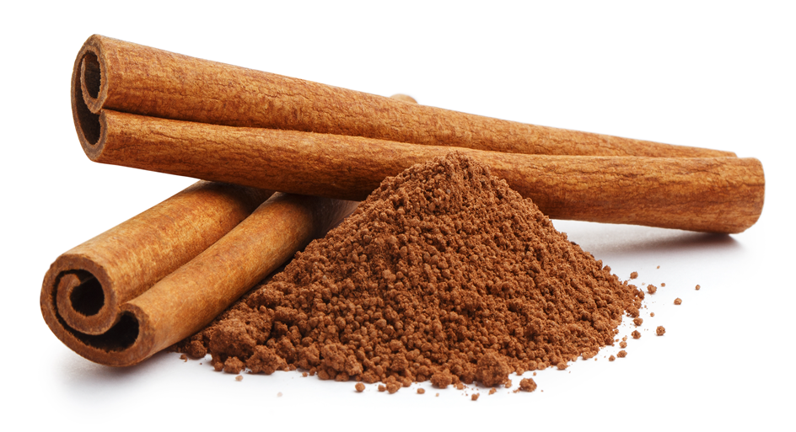
What would Santa smell like? Time to smell!!
Cinnamon
What do you smell?
How would you describe it? Is it…
Spicey, warm, sweet?
Does it remind you of anything?

Slide 11
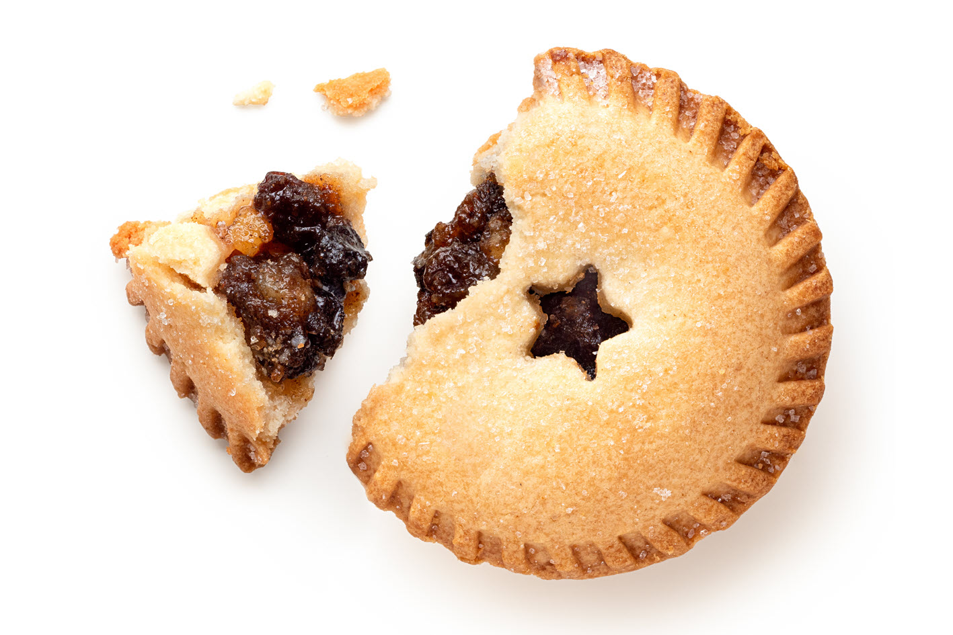
What would Santa smell like? Time to smell!!
Mince pie
What do you smell?
Can you smell…
Apple, sultanas, spices, cinnamon, brandy,
sugar, pastry, butter?

Slide 12
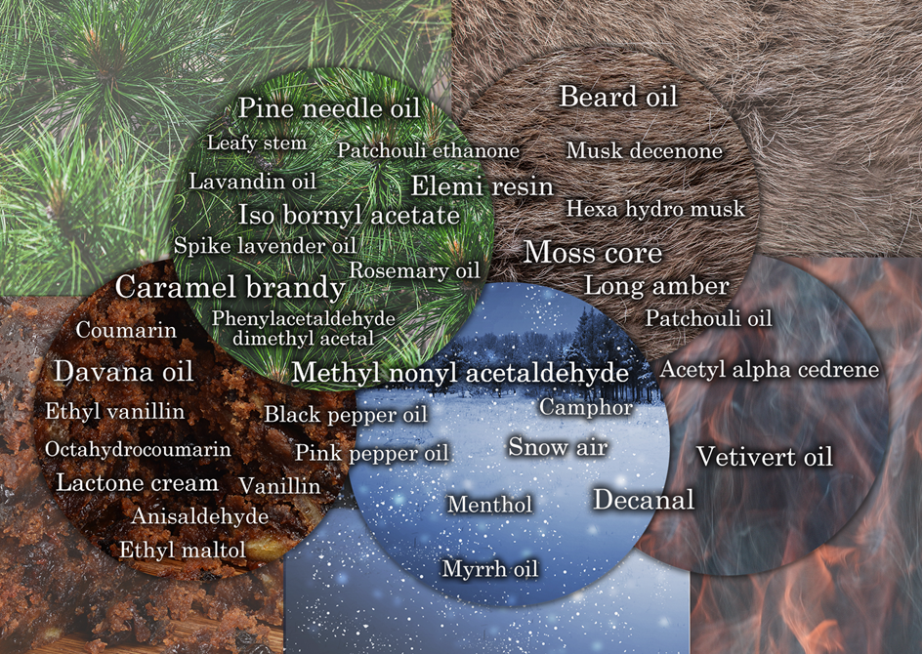
We enjoyed so much finding out about Santa, we made a fragrance to bring all the ideas together! The main odour characters and some of the ingredients are shown here.

Slide 13
Smelly notes!
The human sense of smell is amazing! We take around 20,000 breaths a day and each one is an opportunity to learn about our surroundings.
Through our noses, we can also sense temperature and humidity. Both also affect how well we can smell – and smell is also the flavour of food. If you eat outside on a cold, dry Christmas night, the flavour of your food will seem different compared to eating the same food inside in the warm.
If you hold your nose when eating or drinking, the flavour (odour) changes dramatically - try it!

Slide 14
Smelly notes!
The sense of smell is a ‘chemical sense’. It responds to chemicals in a highly specific way. One of the impacts is that we each smell uniquely – no one senses the world exactly like you.
Inside and up our nose is the olfactory system, including the olfactory bulbs (in blue, left image) which process the odours we smell. The olfactory bulbs are part of the brain linked to other areas involved in memory and emotion. This is the closest link to the brain of any of our senses!
When we smell, we can be instantly and unconsciously reminded of something, someone or some place. When we identify it, this can reinforce the relationship and make recall easier – organizing our olfactory system

Slide 15
Smelly notes!
Our nose is also a funnel to our trigeminal system, which can sense heat (chilli) and cold (menthol). Menthol, found in peppermint and often in toothpaste has a physical cooling effect that we can feel.
When we smell something complex, like a mince pie, we often recognise it as if it has a single odour identity. However, underneath all this our brain has been making patterns between odours all our lives.
If we smell more carefully, then we can smell some of the parts of complex things. If we also have word prompts, then noticing the parts becomes easier. So, maybe we can tell if there is cinnamon in a mince pie.

Slide 16
For more information about our amazing sense of smell, please visit
https://www.fragrancematters.org/

